Slide 1
Vehicle to Vehicle (V2V) Communication System
Prepared by :
Deep Alpesh Patel
Total Quality Project Management ( INSE 6230, Summer 2019)
Faculty Mentor : Dr. Amin Hammad
Concordia University
Montreal, Canada

Slide 2
Outline
Introduction
Scope of V2V
SWOT Analysis
WBS (Mind Mapping approach)
Gantt Chart
Weighted Score Metric
Cost Estimation
Probability / Impact Matrix
Risk Breakdown Structure
Future of V2V Systems
1

Slide 3
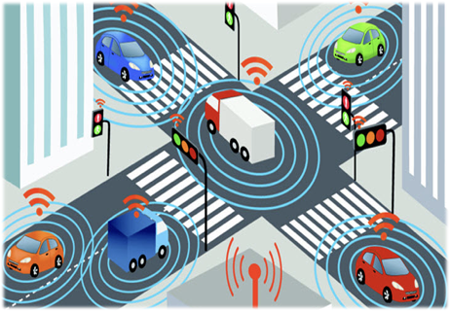
Introduction
What is V2V?
V2V is a crash avoidance technology, which relies on communication of information between nearby vehicles to potentially warn drivers about dangerous situations that could lead to a crash. For example, V2V could help warn a driver that a vehicle up ahead is braking and they need to slow down, or let a driver know that it’s not safe to proceed through an intersection because another car (yet unseen by the driver) is quickly approaching.
How does V2V work?
V2V communications systems are composed of devices, installed in vehicles, that use dedicated short-range radio communication (DSRC) to exchange messages containing vehicle information (e.g., vehicle’s speed, heading, braking status). V2V devices use this information from other vehicles and determine if a warning to the vehicle’s driver is needed, which could prevent a vehicle crash.
Credits : https://daseuropeanautohaus.com/is-a-v2v-communication-system-worth-it/
2

Slide 4
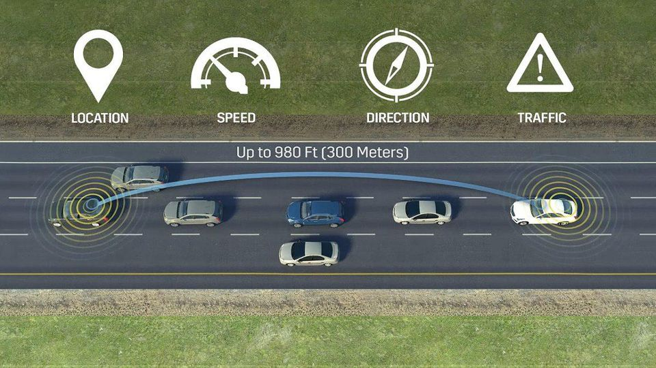
Introduction
2
Credits : https://daseuropeanautohaus.com/is-a-v2v-communication-system-worth-it/

Slide 5
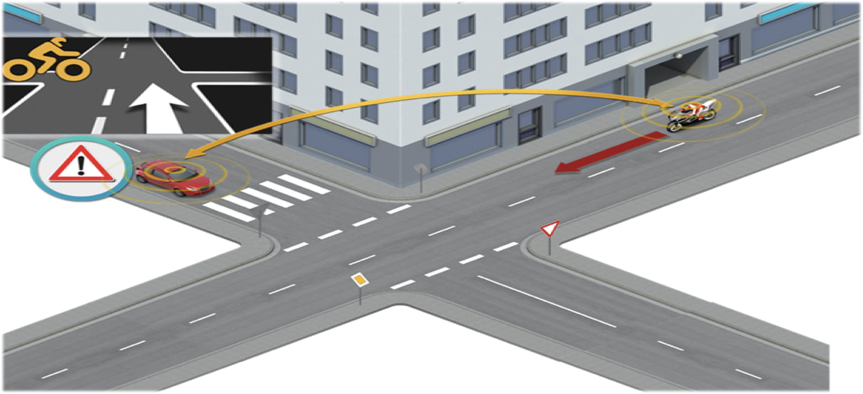
Scope of V2V
Intersection Movement Assist
IMA warns the driver when it’s not safe to enter an inter- section because of an increased potential for colliding with one or more vehicles.
Credits : https://daseuropeanautohaus.com/is-a-v2v-communication-system-worth-it/

Slide 6
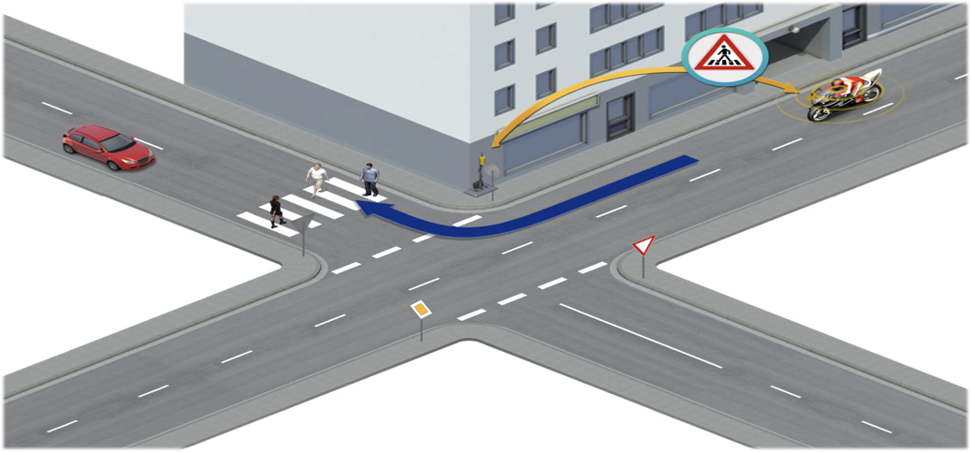
Scope of V2V
Left Turn Assist
LTA warns the driver when there is strong probability they will collide with an oncoming vehicle when making a left turn. This is especially critical when the driver’s line-of- sight is blocked by a vehicle also making a left turn from the opposite direction.

Slide 7
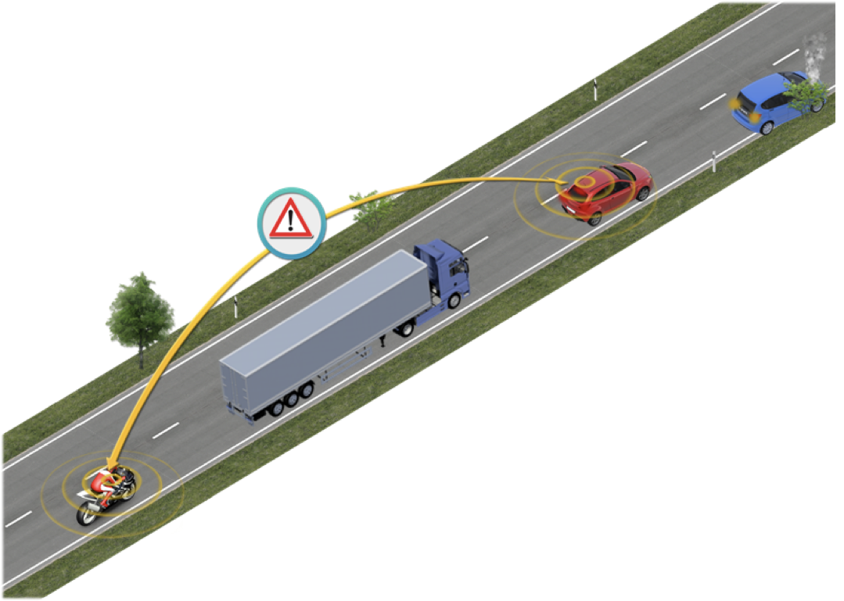
Scope of V2V
Emergency Electronic Brake Light
Emergency Electronic Brake Light (EEBL) warns the driver to be prepared to take action when a V2V-equipped vehicle traveling in the same direction but not in the driver’s line-of-sight decelerates quickly. V2V would allow the driver to “see through” vehicles or poor weather conditions and know if traffic ahead may be coming to an abrupt stop.

Slide 8
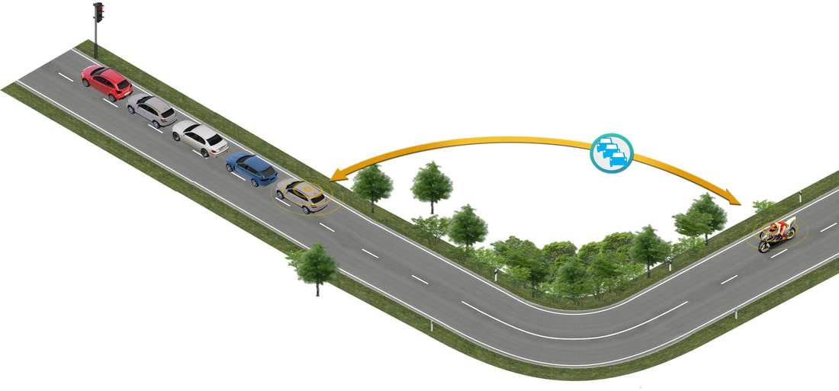
Scope of V2V
Forward Collision Warning
Forward Collision Warning (FCW) warns the driver of the risk of an impending rear-end collision with a vehicle ahead in traffic in the same lane and direction of travel.

Slide 9
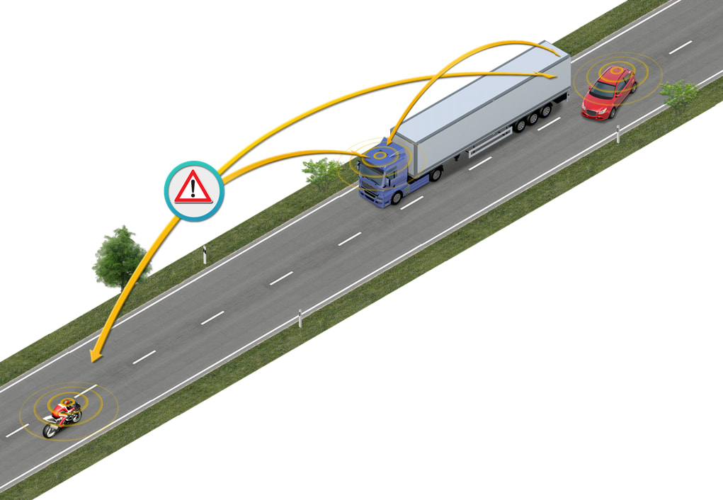
Scope of V2V
Do-Not-Pass Warning
Do-Not-Pass Warning (DNPW) warns the driver that it is not safe to pass a slower-moving vehicle when vehicles are approaching from the opposite direction.

Slide 10
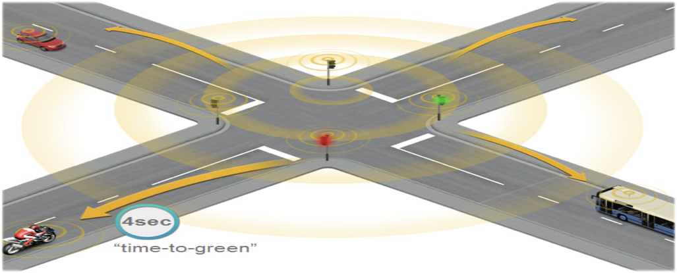
Scope of V2V
Green Light Optimised Speed Advisory
This will enable a smoother traffic flow and optimum efficiency by avoiding unnecessary braking and acceleration. The application can also display the remaining time till green in case the light is red, and so mitigates rider’s stress.

Slide 11
SWOT Analysis
Strengths
Provide accessibility to all drivers
Increases safety and comfort
Smooth traffic flow
Potential to decrease the number of road accidents.
Potential to decrease the number of parking spaces needed
weaknesses
Costs
Most of the countries do not have legislation that allows the use of autonomous vehicles on non-dedicated infrastructure. This is the reality in the Netherlands today.
Electronic security: there may be hacking of the vehicle management system.
Limited wireless/telecom bandwidth availability for V2V communication.
New vehicle models needed to cope with the greater usage intensity of each vehicle.
10

Slide 12
SWOT Analysis
Opportunities
Potential to increase road capacity (shorter headways) and thereby reduce congestion.
Technology maturity may reduce system cost.
sustainability might increase by more fuel efficient driving
Increasing cooperation with AI-software/IT specialist and automotive industry concentrating on development of solutions for automated driving.
Threats
Technology investments needed for supporting the use of the automated vehicle may not be possible due to lack of funds.
Fusion of image and non image data cannot be solved accurately
Uncertainty regarding bandwidth and electromagnetic interference
Lack of sufficient training data
11

Slide 13
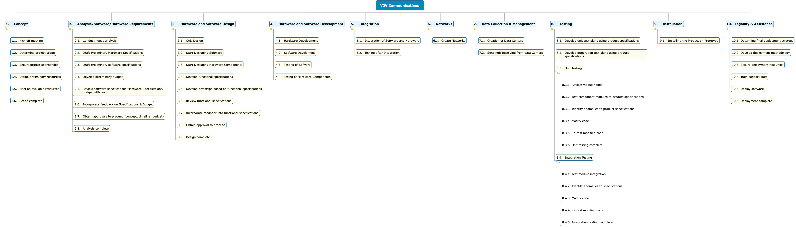
Work Breakdown Structure
12

Slide 14
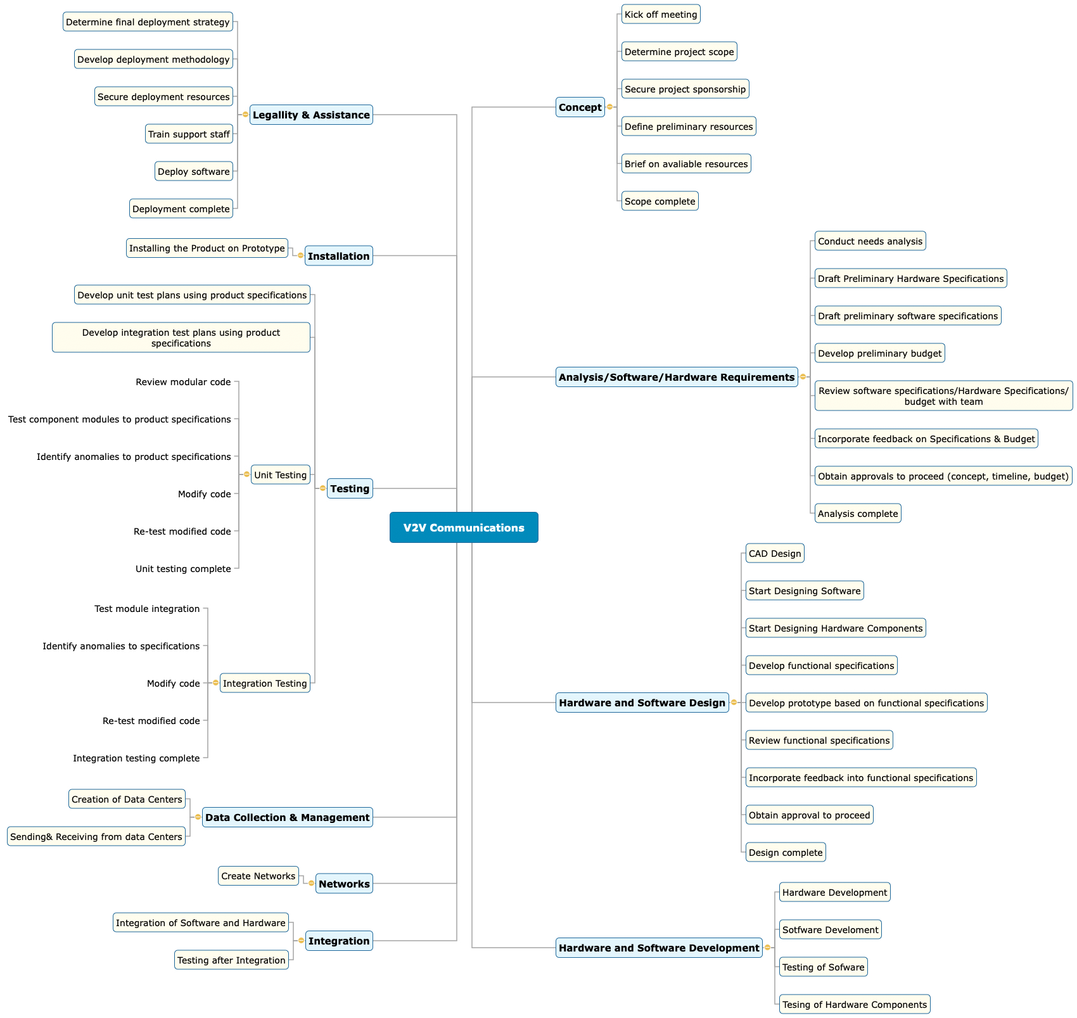
Mind Map
13

Slide 15
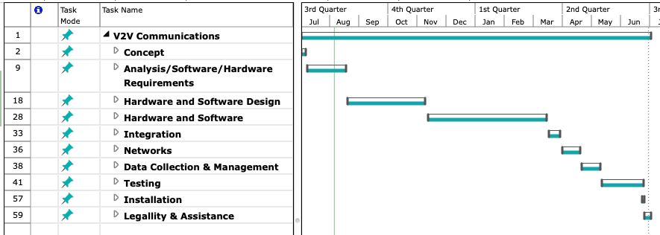
Gantt Chart
21

Slide 16
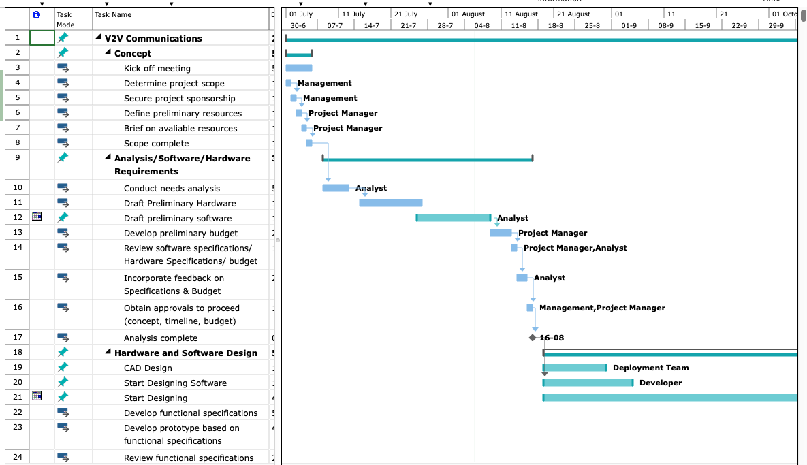
Gantt Chart
21

Slide 17
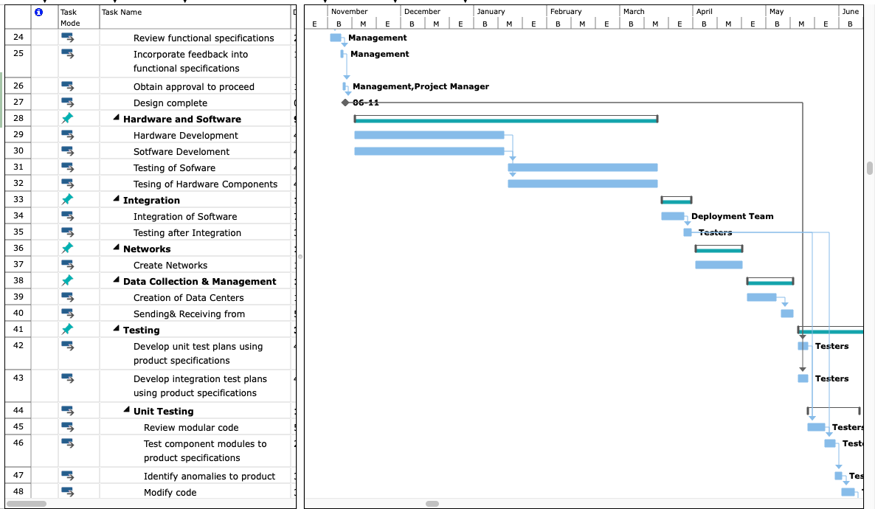
Gantt Chart
21

Slide 18
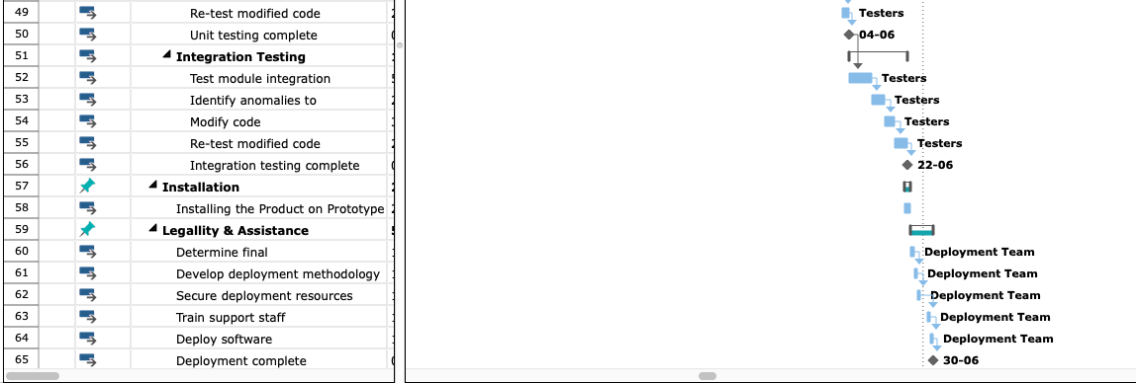
Gantt Chart
Project duration : ~ 1 year
Start Date : 01/07/2019
Closing Date : ~ 02/07/2020
16

Slide 19
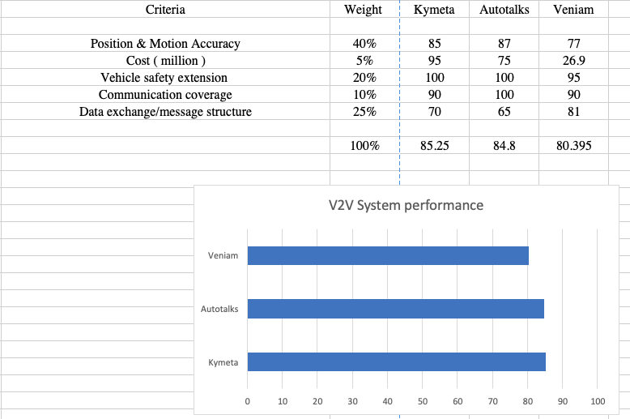
Weighted Score Metric

Slide 20
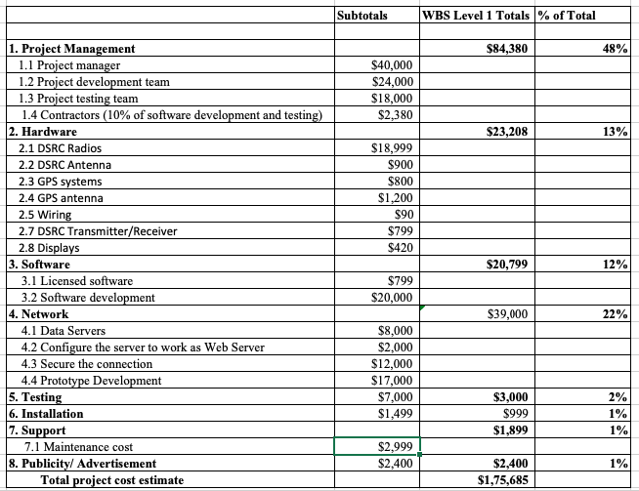
Cost Estimation
18

Slide 21
Probability / Impact Matrix
No. | Risk | Probability | Impact
R1 | Software Manipulation | Low | Medium
R2 | Sensor Manipulation | Low | High
R3 | Jamming the channel | Low | Medium
R4 | Send false messages that cause true messages to be ignore | Medium | High
R5 | Privacy leakage | Medium | Medium
R4 | R5
 | R1,R3 | R2
High
Medium
Low
Probability
High Medium Low
Impact
19

Slide 22
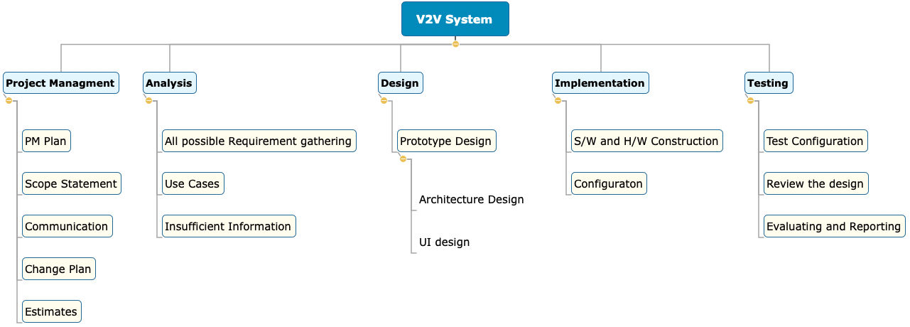
Risk Breakdown Structure
20

Slide 23
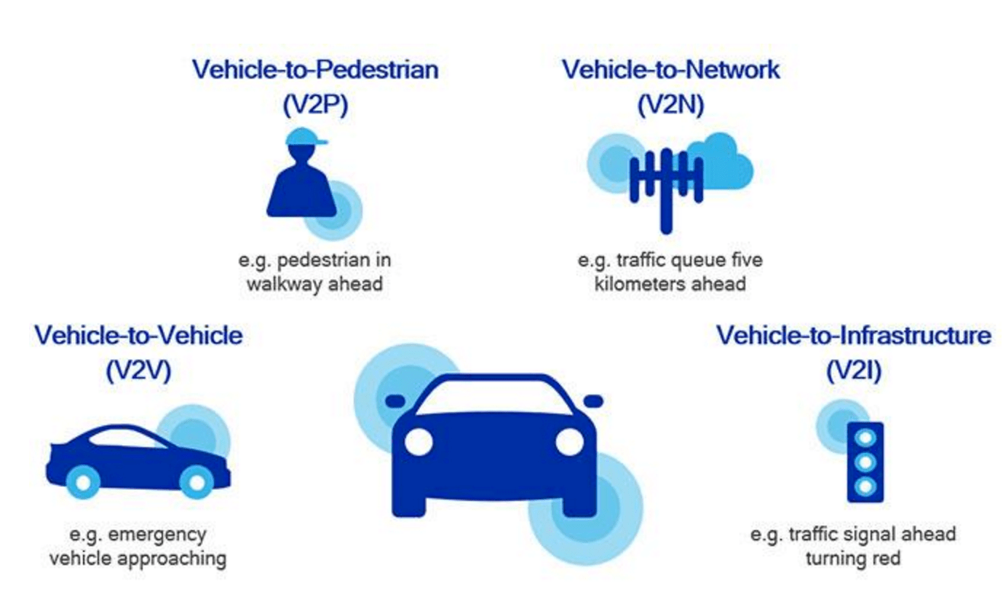
Future of V2V Systems
21
Picture Credits : https://enterpriseiotinsights.com

Slide 24
Thank You

